Slide 1
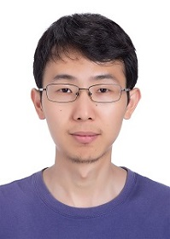
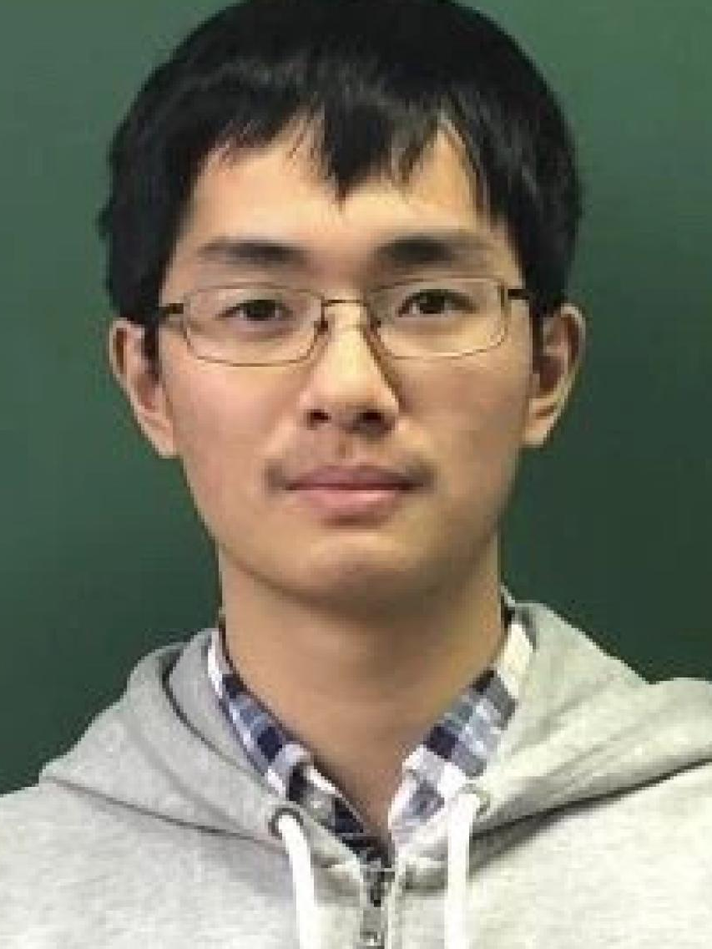
Improved Bounds for Sampling Solutions of Random CNF Formulas
Kuan Yang
(John Hopcroft Center for Computer Science, Shanghai Jiao Tong University)
Joint work with Kun He (Renmin University) and Kewen Wu (UC Berkeley)
2023/09/05, NII Shonan Meeting

Slide 2
Random CNF Formulas
CNF formula: an AND of ORs
$$Φ=\left(x_{1}∨¬x_{2}∨x_{3} \right)∧\left(x_{2}∨x_{3}∨x_{4}\right)∧\left(¬x_{1}∨¬x_{4}∨x_{2}\right)$$
Variables: $x_{1},x_{2},x_{3},x_{4}$
Satisfiable: There exists an assignment to the variables that satisfies all the clauses
$k$-CNF formula: Each clause has exactly $k$ literals
Clause
Literal
Random $k$-CNF formula $Φ(k,n,m)$:
A formula on $n$ variables and $m$ clauses, each clause has exactly $k$ literals
Each literal is chosen independently and uniformly from $\left\{x_{1},…,x_{n},¬x_{1},…,¬x_{n}\right\}$
Density: $α=m/n$
Model: Fix $k$ and $α$, then let $n→∞$ (and $m=αn$)

Slide 3
Questions for Random CNF Formulas
Density: $α=m/n$
Decision: When is $Φ\left(k,n,m\right)$ satisfiable with high probability?
Average-case analysis, phase transition
Satisfiability theorem: For sufficiently large $k$, there exists a bound
$$α^{∗}=2^{k}\ln{2}−\frac{\left(1+\ln{2}\right)}{2}+o_{k}\left(1\right)$$
such that
$$\lim_{n→∞}\operatorname{Pr}{[Φ is satisfiable]}=\left\{\begin{aligned}1 if α<α^{∗} \\ 0 if α>α^{∗}\end{aligned}\right.$$
[KKK’98,F’99,AM’02,AP’03,COP’16,DSS’22]

Slide 4
Questions for Random CNF Formulas
Density: $α=m/n$
Decision: When is $Φ\left(k,n,m\right)$ satisfiable with high probability?
$α≲2^{k}\ln{2}$
Search: Beyond Decision, can we find a solution efficiently?
Algorithmic phase transition
Algorithms: Poly-time algorithm exists when $α≲2^{k}\ln{k}/k$
Hardness: Evidence that the problem is hard when $α≳2^{k}\ln{k}/k$
[CO’10]
[ACO’08, H’16,COHH’17,BH’22]

Slide 5
Questions for Random CNF Formulas
Density: $α=m/n$
Decision: When is $Φ\left(k,n,m\right)$ satisfiable with high probability?
$α≲2^{k}\ln{2}$
Search: Beyond Decision, can we find a solution efficiently?
$α≲2^{k}\ln{k}/k$
Sampling: Beyond Search, can we efficiently sample a uniform random solution from the whole solution space?
Partition function in statistical physics
[MS’07]: $poly\left(n\right)$-time algorithm for $α≲2\ln{k}/k$
[GGGY’21]: $n^{poly\left(k,α\right)}$-time algorithm for $α≲2^{k/300}$

Slide 6
Questions for Random CNF Formulas
Density: $α=m/n$
Decision: When is $Φ\left(k,n,m\right)$ satisfiable with high probability?
$α≲2^{k}\ln{2}$
Search: Beyond Decision, can we find a solution efficiently?
$α≲2^{k}\ln{k}/k$
Sampling: Beyond Search, can we efficiently sample a uniform random solution from the whole solution space?
$α≲2^{k/300}$ and $n^{poly\left(k,α\right)}$-time
Our focus

Slide 7
Questions for Random CNF Formulas
Density: $α=m/n$
Decision: When is $Φ\left(k,n,m\right)$ satisfiable with high probability?
$α≲2^{k}\ln{2}$
Search: Beyond Decision, can we find a solution efficiently?
$α≲2^{k}\ln{k}/k$
Sampling: Beyond Search, can we efficiently sample a uniform random solution from the whole solution space?
$α≲2^{k/300}$ and $n^{poly\left(k,α\right)}$-time
Our result:
$α≲2^{k/3}$ and $n^{1.0001}$-time

Slide 8
Phase Transition of the Solution Space
Decision: When is $Φ\left(k,n,m\right)$ satisfiable with high probability?
$α≲2^{k}\ln{2}$ ($α_{s}$)
Search: Beyond Decision, can we find a solution efficiently?
$α≲2^{k}\ln{k}/k$ (conjectured to be $α_{d}≈2^{k}(\ln{k}+\ln{\ln{k}})/k$)
Sampling: Beyond Search, can we efficiently sample a uniform random solution?
$α≲2^{k/3}$ (???)

Slide 9
Random vs Standard $k$-CNF Formulas
Each clause has $k$ variables
The average variable degree in $Φ\left(k,n,m\right)$ is $d=\frac{km}{n}=kα$
If a $k$-CNF formula has maximum variable degree $d$, then
Satisfiability threshold: $d≲2^{k}/k$ [Lovász local lemma, EL’75]
Search threshold: $d≲2^{k}/k$ [Algorithmic local lemma, MT’10]
Sampling bound
Algorithm: $d≲2^{k/5}$ [He-Wang-Yin’22, 09:45 – 10:25 this morning]
Hardness: $d≳2^{k/2}$ [BGGGS’19]

Slide 10
Random vs Standard $k$-CNF Formulas
 | Maximum degree $d=kα$ | Average degree $d=kα$
Satisfiability | $$α≲2^{k}/k^{2}$$ | $$α≲2^{k}\ln{2}$$
Search | $$α≲2^{k}/k^{2}$$ | $$α≲2^{k}\ln{k}/k$$
Sampling algorithm | $$α≲2^{k/5}$$ | $$α≲2^{k/300}$$
Sampling hardness | $$α≳2^{k/2}$$
Intuitively
Random $k$-CNF is slightly better than standard $k$-CNF in satisfiability and search
Conjecture
Random $k$-CNF is slightly better than standard $k$-CNF also in sampling
easier, but not much easier

Slide 11
Random vs Standard $k$-CNF Formulas
 | Maximum degree $d=kα$ | Average degree $d=kα$
Satisfiability | $$α≲2^{k}/k^{2}$$ | $$α≲2^{k}\ln{2}$$
Search | $$α≲2^{k}/k^{2}$$ | $$α≲2^{k}\ln{k}/k$$
Sampling algorithm | $$α≲2^{k/5}$$ | $$α≲2^{k/3}$$
Sampling hardness | $$α≳2^{k/2}$$ | ?
Intuitively
Random $k$-CNF is slightly better than standard $k$-CNF in satisfiability and search
Conjecture
Random $k$-CNF is slightly better than standard $k$-CNF also in sampling
Disadvantage: maximum degree $O\left({\log{n}}/{\log{\log{n}}}\right)$ (constant fraction of variables)
Advantage: structural properties of random instances

Slide 12
Recursive Sampler [AJ’21, HWY’22]
Assume we want to sample ${σ(x}_{1})$ from $μ_{x_{1}}$
$μ_{x_{1}}\left(⋅\right)$ is the marginal distribution of $x_{1}$ in a uniform solution
$μ_{x}(⋅)$ have lower bounds
(using local uniformity)
$μ_{x_{1}}\left(⋅\right)=μ_{x_{2}}\left(0\right)⋅μ_{x_{1}}\left( ⋅ | σ\left(x_{2}\right)=0\right)+μ_{x_{2}}\left(1\right)⋅μ_{x_{1}}\left( ⋅ | σ\left(x_{2}\right)=1\right)$
$μ_{x_{1}}\left(⋅| σ\left(x_{2}, x_{3},…, x_{i}\right)\right)=\sum_{j=0}^{1}{μ_{x_{i+1}}\left(j \right| σ(x_{2}, …, x_{i}))⋅}$ $μ_{x_{1}}\left(⋅| σ\left(x_{2},…, x_{i+1}\right)\right)$
We first sample $σ\left(x_{2}\right),σ\left(x_{3}\right),…$
where $σ\left(x_{i}\right)$ is sampled from $μ_{x_{i}}\left( ⋅ \right| σ(x_{2},…,x_{i−1}))$
Once a clause is satisfied, it “vanishes”
False ($0$)
$$?$$
True ($1$)
$$x_{1}$$
$$x_{2}$$
$$x_{4}$$
$$x_{5}$$
$$x_{3}$$

Slide 13
Recursive Sampler [AJ’21, HWY’22]
Assume we want to sample ${σ(x}_{1})$ from $μ_{x_{1}}$
$μ_{x_{1}}\left(⋅\right)$ is the marginal distribution of $x_{1}$ in a uniform solution
$μ_{x}(⋅)$ have lower bounds
(using local uniformity)
$μ_{x_{1}}\left(⋅\right)=μ_{x_{2}}\left(0\right)⋅μ_{x_{1}}\left( ⋅ | σ\left(x_{2}\right)=0\right)+μ_{x_{2}}\left(1\right)⋅μ_{x_{1}}\left( ⋅ | σ\left(x_{2}\right)=1\right)$
$μ_{x_{1}}\left(⋅| σ\left(x_{2}, x_{3},…, x_{i}\right)\right)=\sum_{j=0}^{1}{μ_{x_{i+1}}\left(j \right| σ(x_{2}, …, x_{i}))⋅}$ $μ_{x_{1}}\left(⋅| σ\left(x_{2},…, x_{i+1}\right)\right)$
We first sample $σ\left(x_{2}\right),σ\left(x_{3}\right),…$
where $σ\left(x_{i}\right)$ is sampled from $μ_{x_{i}}\left( ⋅ \right| σ(x_{2},…,x_{i−1}))$
Once a clause is satisfied, it “vanishes”
Suppose $σ(x_{2})$satisfies the dashed clauses. Then …
Conditioned on $σ(x_{2})$, $x_{1}, x_{4}$ are independent!
False ($0$)
$$?$$
True ($1$)
$$x_{1}$$
$$x_{2}$$
$$x_{4}$$
$$x_{5}$$
$$x_{3}$$

Slide 14
Solving Random Instances
Main difficulty: high-degree variables having no local uniformity
Partition variables into Good part and Bad part
Only Good variables are guaranteed to have local uniformity
For Bad variables, use rejection sampling directly
For Good variables, low-degree is necessary, but not sufficient
How large the local uniformity do we need?
Strong local uniformity requires to fix few variables
Efficiency of rejection sampling requires small size of unsatisfied clauses
$⇒$ have to fix many variables

Slide 15
Solving Random Instances
If a CNF formula satisfies
Each variable has degree at most $d≲2^{k/3}$
Each clause has at least $0.9k$ distinct variables
then it is satisfiable and has local uniformity
$$\underset{σ∼{\left\{0,1\right\}}^{n}}{Pr}\left[σ\left(x_{i}\right)=0∣σ is a solution\right]∈\frac{1}{2}±2^{−0.6k}$$
$⇒$ good marginal approximation
In $Φ=Φ\left(k,n,m\right)$, we say a variable is Bad if
It has degree larger than $d$
Or it is in a clause that contains more than $0.1k$ Bad variables
The remaining variables are Good: local uniformity guaranteed
$$α=m/n≲2^{k/3}$$

Slide 16
Proof Overview
Classify the variables into Good or Bad
For Good variables, we sample one by one from its marginal distribution over uniform solution
Marginal sampler [AJ’21, HWY’22]
Conditioned on the assignments on Good variables, we sample values for Bad variables
Standard rejection sampling
Efficiency: locally sparse properties of random $k$-CNF formulas

Slide 17
Marginal Sampler
Assume we want to sample ${σ(x}_{1})$ from $μ_{x_{1}}$ for a Good variable $x_{1}$
$μ_{x_{1}}\left(⋅\right)$ is the marginal distribution of $x_{1}$ in a uniform solution
By local uniformity, we fix
$$σ\left(x_{1}\right)=\left\{\begin{aligned}0 \text{w}\text{.}\text{p} 1/2−2^{−0.6k} \\ 1 \text{w}\text{.}\text{p} 1/2−2^{−0.6k} \\ ⋆ \text{w}\text{.}\text{p} {2⋅2}^{−0.6k}\end{aligned}\right.$$
If $σ\left(x_{1}\right)= ⋆$, then resample it under distribution $ρ_{x_{1}}∝μ_{x_{1}}−1/2+2^{−0.6k}$
Bernoulli factory [NP’05, H’16, DHKN’17]
$ρ_{x_{1}}$ can be efficiently sampled given samples from $μ_{x_{1}}$.

Slide 18
Marginal Sampler
Assume we want to sample ${σ(x}_{1})$ from $μ_{x_{1}}$ for a Good variable $x_{1}$
$μ_{x_{1}}\left(⋅\right)$ is the marginal distribution of $x_{1}$ in a uniform solution
By local uniformity, we sample $σ\left(x_{1}\right)←0,1, ⋆$
If $σ\left(x_{1}\right)∈\left\{0,1\right\}$, then simply return it
Otherwise resample it using Bernoulli factory on $μ_{x_{1}}$
Recursive sampling
Lazy Sampling
Assume the values of $x_{2},x_{3},…$are sampled correctly conditioned on $σ\left(x_{1}\right)= ⋆$
Then we can easily sample from $μ_{x_{1}}( ⋅ ∣σ\left(x_{2}\right),σ\left(x_{3}\right),…)$,
which equals $μ_{x_{1}}$ over random $σ\left(x_{2}\right),σ\left(x_{3}\right),…$
To obtain $σ\left(x_{2}\right)$ conditioned on $σ\left(x_{1}\right)= ⋆$, we execute marginal sampler on $x_{2}$ with $x_{1}$ fixed as $⋆$

Slide 19
Efficiency
To obtain a sample $σ\left(x_{1}\right)$,
First use local uniformity to get an approximate, which stops already whp
If not stop,
We sample $σ\left(x_{2}\right)$ conditioned on the value of $x_{1}= ⋆$
We sample $σ\left(x_{3}\right)$ conditioned on the value of $x_{1}= ⋆,{σ(x}_{2})$
…… (whenever local uniformity holds)
Finally use Bernoulli factory on $μ_{x_{1}}\left( ⋅ ∣ σ\left(x_{2}\right),σ\left(x_{3}\right),…\right)$
The latter is provided by rejection sampling conditioned on $σ\left(x_{2}\right),σ\left(x_{3}\right),…$
Strong local uniformity
Tradeoff
The remaining formula isn’t too large
$⇒$ Fix many variables before reaching here
$⇒$ Local uniformity can’t be too strong
Efficiency

Slide 20
Beyond Bounded-degree Results
How to bound the size of remaining formulas?
All related proofs analyzed the probability of nonvanishing clauses
Bounded degree formulas may be dense locally
$\left\{2, 3\right\}$-tree was used to capture independence
This is not a typical random instance!
Random formulas are typically sparse
Average degree $≤1.001$ in $O(\log{n})$-size components
No Bad variable clusters
Duplicated variables are few in the resampling components
Analyze the probability of fixing too many variables

Slide 21
Summary of Efficiency Analysis
The rejection sampling is efficient if the remaining formula is small
Bad variables are few
Good variables have many possible solutions
The recursion has small depth
Most Good variables are in the recursion
The local uniformity sampling stops w.h.p.
Local sparsity
Local uniformity

Slide 22
Conclusion and Conjectures
Satisfiability threshold
Efficient search
Density: $α=m/n$
$$2^{k/300}$$
$$2^{k/3}$$
$$2^{k/2}$$
$$α=0$$
$$α→∞$$
$$2^{k}\ln{k}/k$$
$$2^{k}\ln{2}$$
Trivial formula
Efficient sampling
Efficient sampling
?
Thank you !

