Slide 1
Arabic Language Challenges
Walid Magdy

Slide 2
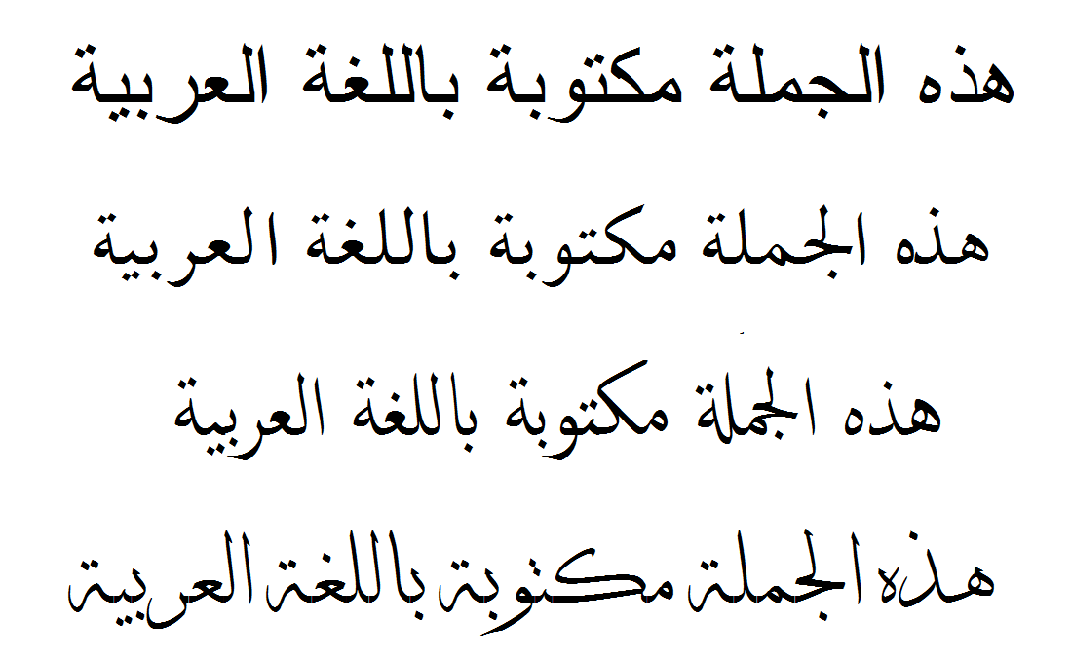
This sentence is written in Arabic

Slide 3
Outlines
  Arabic language
  Why we analyze?
  Arabic language challenges:
    Orthographical challenges
    Morphological challenges
    Phonetic challenges
  Conclusion

Slide 4
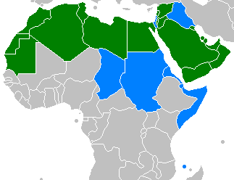
Arabic Language
  Arabic is the largest living member of the Semitic language family
  It is classified as a macro-language with 27 sub-languages
  It is spoken by over 220 million people in 28 countries (middle-east)
  The language of Quran (over 1.6 billion Muslims)

Slide 5
Why we analyze?
  Many enabling technologies nowadays are language dependent such as:
    Optical Character Recognition (OCR)
    Language Modeling (LM)
    Name Entity Recognition (NER)
    Speech Recognition (ASR)
  Performance of these technology with Arabic is much lower than other languages

Slide 6
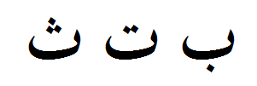

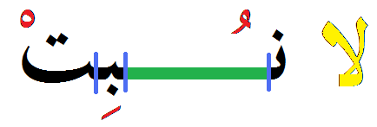
Orthographic Challenges of Arabic
  - 15 of the 28 letters contain dots
  - Characters are connected
  - Character shape depends on position
  - Optional diacritics may be present
  - Printed text may include ligatures and kashida

Slide 7
Morphological Challenges of Arabic
  - Language is built of 10k roots
  - Words contain prefix, infix, and suffix
  - 60 billion possible surface forms
  - Word spelling changes according to its position in the sentence
  He loves his children
  His children loves him
  The children behaved well
  Her children are cute
وسـيــكـتبونـهـا
wasaya+ktub+unahaa
and will + write + they it
= and they will write it

Slide 8
Phonetic Challenges of Arabic
  Some phonemes are in Arabic doesn’t exist in other language (‘ein, ghain, ha’, kha’, Dad, Sad, Hamza)
  Examples:
  Motaz (‘ein)
  Mahmoud (ha’)
  Ghada (ghain)
  Diaa (Dad)
  Khaled (7’a’)

Slide 9
Conclusion
  Arabic language is important
  Performance of language dependent technologies is low with Arabic
  Fact: Arabic language is more challenging than others
  Much investigation is needed especially from people of this language

Slide 10
أهنالك أي أسئلة؟

