Slide 1
The Role of Machine Learning in NLP
or
Confessions of an Addict:
Machine Learning as the Steroids of NLP
Eduard Hovy
USC Information Sciences Institute
www.isi.edu/~hovy

Slide 2
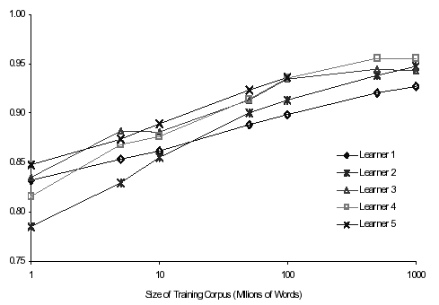
Lesson 1: Banko and Brill, HLT-01
Task: Confusion set disambiguation:
{you’re | your}, {to | too | two}, {its | it’s}
5 Algorithms: ngram table, winnow, perceptron, transformation-based learning, decision trees
You don’t need a smart algorithm,
you just need enough training data
Training: 10⁶ → 10⁹ words
Lessons:
All methods improved to almost same point
Simple method can end above complex one
Don’t waste your time with algorithms and optimization

Slide 3
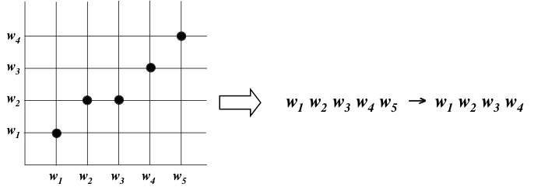
Lesson 2: Och, ACL-02
Best MT system in world (Arabic→English, by BLEU and NIST, 2002–2005): Och’s work
Method: learn ngram correspondence patterns (alignment templates) using MaxEnt (log-linear translation model), trained to maximize BLEU score
Approximately: EBMT + Viterbi search
Lesson: the more you store, the better your MT
You don’t have to be smart,
you just need enough storage

Slide 4
Storage needs
Unigram translation table: bilingual dictionary
200K words each side (2MB if each word is 10 chars)
Bigram translation table (every bigram):
Lexicon: 200K = 2¹⁸ words
Table entries: [200K × 200K words + translations] = 4 × 10¹⁰ entries
Each entry size = 4 words × 18 bits = 9 bytes
4 × 10¹⁰ entries × 9 bytes = 36 × 10¹⁰ ≈ 4 × 10¹¹ bytes = 0,4 TB (under $1000 at today’s prices!)
Trigram translation table (every trigram):
1,2 × 10⁵ TB — ready in 2008?
Better: store only attested ngrams (up to 5? 7? 9?), fall back to shorter ones when not in table…
Carbonell et al. MT system…all 8grams of English

Slide 5
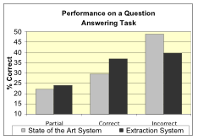
Lesson 3: Fleischman and Hovy, ACL-03
Text mining: classify locations and people in free-form text into fine-grain classes
Simple appositive IE patterns (“Quarterback_{ROLE} Joe Smith_{PER}”)
2+ mill examples, collapsed into 1 mill instances (avg: 2 mentions/instance, 40+ for George W. Bush)
Test: QA on “who is X?”:
100 questions from AskJeeves
System 1: Table of instances
System 2: ISI’s TextMap QA system
Table system scored 25% better
Over half of questions that TextMap got wrong could have benefited from information in the concept-instance pairs
This method took 10 seconds, TextMap took ~9 hours
You don’t have to reason,
you just need to collect the knowledge beforehand

Slide 6
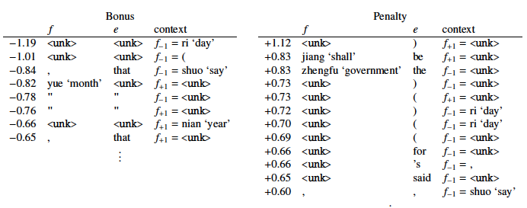
Lesson 4: Chiang et al., HLT-2009
“11,001 New Features for Statistical MT”. David Chiang, Kevin Knight, Wei Wang. 2009. Proc. NAACL HLT. Best paper award
Learn Eng–Chi MT rules: NP-C(x0:NPB PP(IN(of x1:NPB)) <–> x1 de x0
Featurize everything:
Several hundred count features : reward frequent rules; punish rules that overlap; punish rules that insert is, the, etc. into English …
10,000 word context features: for each triple (f; e; f₊₁), feature that counts the number of times that f is aligned to e and f₊₁ occurs to the right of f; and
You don’t have to know anything, you just need enough features
similarly for triples (f; e; f₋₁) with f₋₁ occurring to the left of f. Restrict words to the 100 most frequent in training data

Slide 7
Four lessons
You don’t need a smart algorithm, you just need enough training data
You don’t have to be smart, you just need enough memory
You don’t have to be smart, you just need to collect the knowledge beforehand
You don’t have to be smart, you just need enough features
— the web has all you need
— memory gets cheaper
— computers get faster
— copy features from everyone
…we are moving to a new world:
NLP as table lookup
Conclusion:

Slide 8
So what?

Slide 9
Performance ceilings
Reliable surface-level preprocessing (POS tagging, word segmentation, NE extraction, etc.): 94%+
Shallow syntactic parsing: 93%+ for English (Charniak, Stanford, Lin) and deeper analysis (Hermjakob)
IE: ~0.4–0.7 F-score for easy topics (MUC, ACE)
Speech: ~80% word correct rate (large vocab); 20%+ (open vocab, noisy input)
IR: 0.45–0.6 F-score (TREC)
MT: ~70% depending on what you measure
Summarization: ? (~0.6 F-score for extracts; DUC, TAC)
QA: ? (~60% for factoids; TREC)
90s–
00s–
80s–
80s–
90s–
90s–
00s–
90s–

Slide 10
Why we’re stuck
Just need better learning algorithms?
New algorithms do do better, but only asymptotically
More data?
Even Google with all its data can’t crack MT
Better and deeper representations / features?
Best MT now uses syntax; best QA uses inference
A need for semantics, discourse, pragmatics…?

Slide 11
The danger of steroids
In NLP, we have grown lazy:
When we asymptote toward a performance ceiling,
we don’t think,
we just look for the next sexy ML algorithm

Slide 12
What have we learned about NLP?
Most NLP is notation transformation:
(Eng) sentence → (Chi) sentence (MT)
(Eng) string → parse tree → frame
case frame → (Eng) string (NLG)
sound waves → text string (ASR)
long text → short text (Summ, QA)
…with some information added:
Labels: POS, syntactic, semantic, other
Brackets
Other associated docs
FIRST, you need theorizing: designing the types, notation, model: level and formalism
And THEN you need engineering: Selecting and tuning learning performance — a (rapid) build-evaluate-build cycle

Slide 13
A hierarchy of transformations
Transformations at abstract level: filter, match parts, etc.
Some transforms are ‘deeper’ than others
Each layer of abstraction defines classes/types of behavioral regularity
These types solve the data sparseness problem
Deep semantics: ?
Shallow semantics:
frames
Adding more: semantic features
Analysis
Generation
Mid-level changes: syntax
Adding info: POS tags, etc.
Small changes: demorphing, etc.
Direct: simple replacement

Slide 14
More phenomena of semantics
Somewhat easier
Word sense selection (incl. copula)
NP structure: genitives, modifiers…
Entity identification and coreference
Pronoun classification (ref, bound, event, generic, other)
Temporal relations (incl. discourse and aspect)
Manner relations
Spatial relations
Comparatives
Quotation and reported speech
Opinions and other judgments
Event identification and coreference
Bracketing (scope) of predications
More difficult / ‘deeper’
Quantifier phrases and numerical expressions
Concept structure (incl. frames and thematic roles)
Coordination
Info structure (theme/rheme, Focus)
Discourse structure
Modals and other adverbials (epistemic modals, evidentials)
Concepts: ontology definition
Pragmatics and Speech Acts
Polarity/negation
Presuppositions
Metaphors

Slide 15
The better and more refined the representation levels we introduce, the better the quality of the output
…and the more challenges and opportunities for machine learning

Slide 16
So, what to do?
Some NLP people need to kick the habit: No more steroids, just hard thought
Other NLP people can continue to play around with algorithms
For them, you Machine Learning guys are the pushers and the pimps!

Slide 17
So you may be happy with this,
but I am not … I want to understand what’s going on in language and thought
We have no theory of language or even of language processing in NLP
Chasing after another algorithm that will be hot for 2 or 4 years is not really productive
How can one inject understanding?

Slide 18
The role of corpus creation
Basic methodological assumptions of NLP:
Statistical NLP: process is (somewhat) nondeterministic; probabilities predict likelihood of products
Underlying assumption: as long as annotator consistency can be achieved, there is systematicity, and systems will learn to find it
Theory creation (and testing!) through corpus annotation
But we (still) have to manually identify generalizations (= equivalence classes of individual instances of phenomena) to obtain expressive generality/power
This is the ‘theory’
(and we need to understand how to do annotation properly)
A corpus lasts 20 years; an algorithm lasts 3 years

Slide 19
Annotation!
1. Preparation
Choose the corpus
Build the interfaces
2. Instantiating the theory
Create the annotation choices
Test-run them for stability
3. Annotation
Annotate
Reconcile among annotators
4. Validation
Measure inter-annotator agreement
Possibly adjust theory instantiation
5. Delivery
Wrap the result
Which corpus?
Interface design issues
How remain true to theory?
How many annotators?
Which procedure?
Which measures?
‘annotation science’

Slide 20
A fruitful cycle
Analysis, theorizing, annotation
Linguists, psycholinguists, cognitive linguists…
problems: low performance
annotated corpus
evaluation
Storage in large tables, optimization, commercialization
Machine learning of transformations
Current NLP researchers
NLP companies
automated
creation
method
Each one influences the others
Different people like different kinds of work

Slide 21
How can you ML guys help?
Don’t give us yet another cool algorithm
(all they do is another feature-based clustering)
Do
Help us build corpora
Tell us when to use which algorithm

Slide 22
It’s all about features
Feature design:
Traditionally, concern of domain and task expert
Feature ranking & selection:
Traditional main focus of ML

Slide 23
What would be really helpful
Input: Dimensions of choice, for each new problem
Training data:
Values: numerical (continuous) or categorical
Skewedness: dependency on balanced/representative samples
Granularity: ‘delicacy’ of differentiation in feature space
Training session:
Storage and processing requirements
Speed of convergence
Output: Expected accuracies, for different amounts of training data, for each learning algorithm

Slide 24
Help me…
Help me know what algorithm to use
Help me recognize when something is seriously amiss with the algorithm, not just with my data…then I can contact you
Help my students kick the steroid habit and learn the value of thinking!

Slide 25
Thank you!
NO PIMPS

Slide 26
Some readings
Feature design:
Rich Caruana, Alexandru Niculescu-Mizil. 2006. An Empirical Comparison of Supervised Learning Algorithms. Proceedings of the 23rd International Conference on Machine Learning (ICML `06).
Alexandru Niculescu-Mizil, Rich Caruana. 2005. Predicting Good Probabilities With Supervised Learning. Proceedings of the 22nd International Conference on Machine Learning (ICML `05). Distinguished student paper award.
Rich Caruana, Alexandru Niculescu-Mizil. 2004. Data Mining in Metric Space: An Empirical Analysis of Supervised Learning Performance Criteria. Proceedings of the 10th International Conference on Knowledge Discovery and Data Mining (KDD `04).
David B. Skalak, Alexandru Niculescu-Mizil, Rich Caruana. 2007. Classifier Loss under Metric Uncertainty. Proceedings of the 18th European Conference on Machine Learning (ECML `07).

