Slide 1
Accurate Binary Image Selection From Inaccurate User Input
Kartic Subr, Sylvain Paris, Cyril Soler, Jan Kautz
University College London, Adobe Research, INRIA-Grenoble

Slide 2
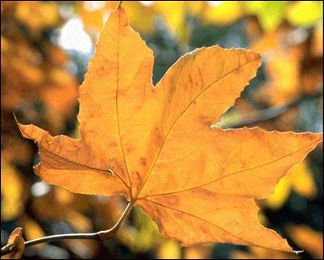
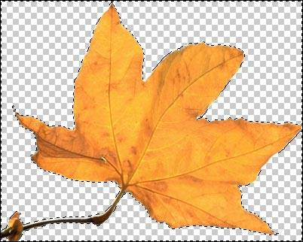
Selection is a common operation in images

Slide 3
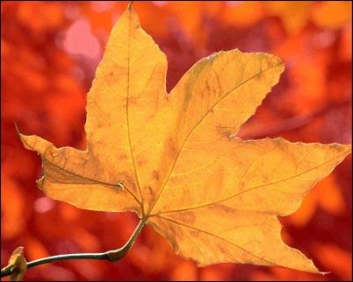
For example

Slide 4
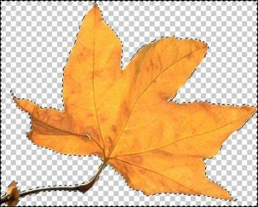
Tools available: Related work
Simple brush and lasso
magnetic lasso [MB95]
edge-aware brush [CPD07,OH08]
for multi-touch screens [BWB06]
User indication
bounding box [RKB04]
scribbles [BJ01, ADA*04, LSS09, LAA08]

Slide 5
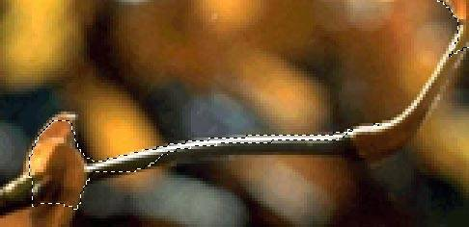
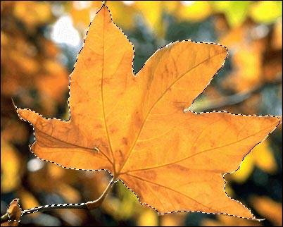
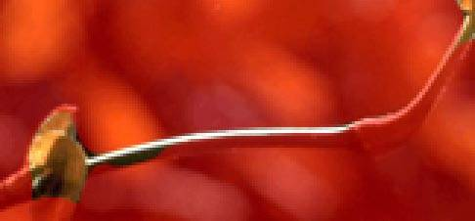
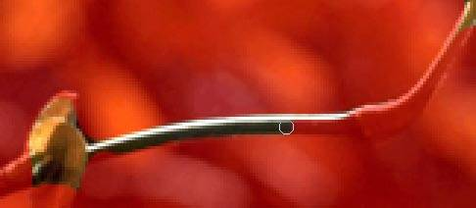
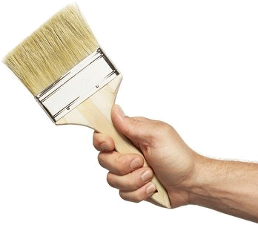
Accurate marking can be tedious

Slide 6
Precise input requires skill…

Slide 7
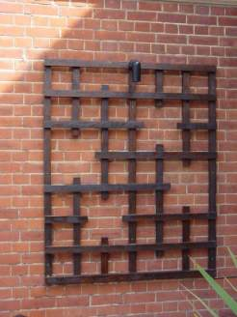
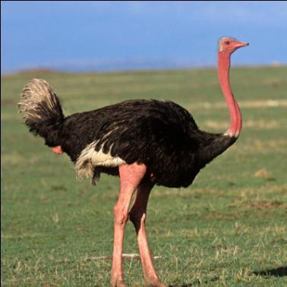
… and patience

Slide 8
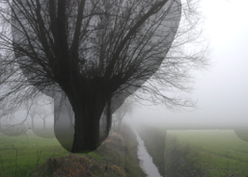
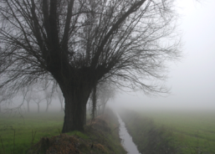
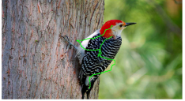
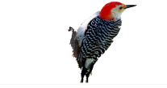
Robust approaches: Related work
soft selection
AppProp [AP08]
instant propagation [LJH10]
interactive segmentation
dynamic, iterative graph cut [SUA12]

Slide 9
Summary of related work
Accurate methods
require precise input
unstable
Robust methods
not accurate
marking is not intuitive

Slide 10
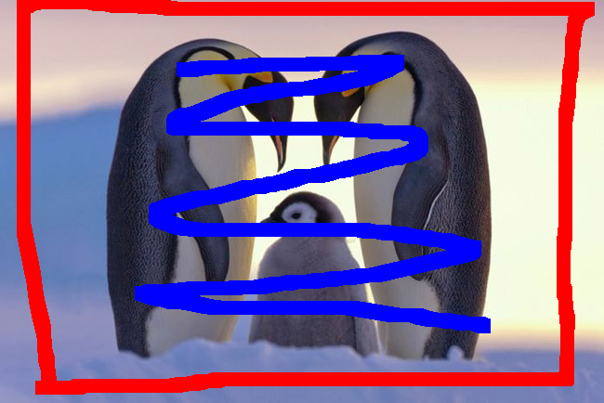
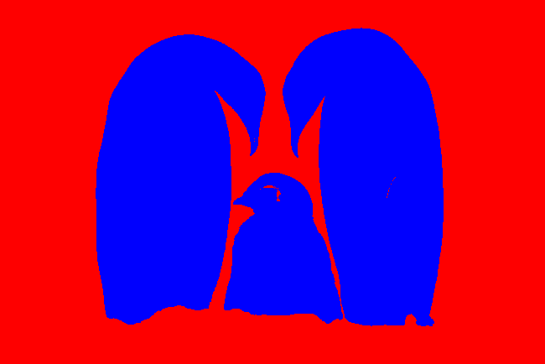
Ours: intuitive, robust, fast
Input
Output
foreground scribble
foreground
background
background scribble

Slide 11
Bird’s eye view
formulate as image-labeling problem
labels: foreground, background, void
Input
histogram of probabilities for each label
Output
each pixel assigned foreground/background label

Slide 12
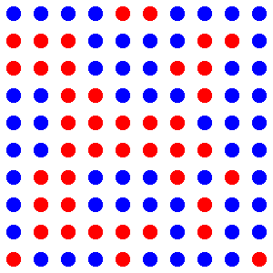
Formulate as labeling problem
b
f
Labeling
probability
v
pixel grid
labeled pixel grid

Slide 13
Formulate as labeling problem
t
b
f
probability
v
pixel grid
labeled pixel grid

Slide 14
Histogram of probabilities using input scribbles
fg | bg | void
0.5 | 0.25 | 0.25
0.25 | 0.5 | 0.25
0.33 | 0.33 | 0.33

Slide 15
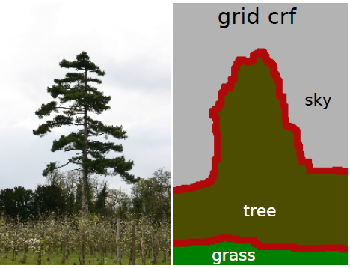
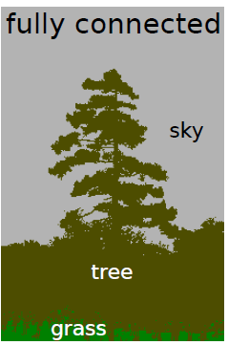
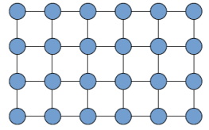
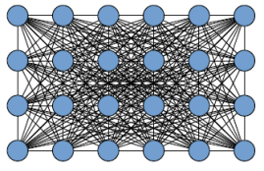
Labeling: MAP inference in dense CRF [KK2011]
approximate
fast: 0.2 s (50K vars)
reduces to bilateral filtering

Slide 16
Labeling: MAP inference in dense CRF [KK2011]
approximate
fast: 0.2 s (50K vars)
reduces to bilateral filtering
Low memory requirement
does not store full distance matrix between pixels

Slide 17
Fast inference assumes Gaussian kernel [KK2011]
Pair-wise potential (between pixels)
linear sum of Gaussians
Gaussians over Euclidean feature space
We generalize to arbitrary kernels!

Slide 18
Generalizing MAP inference to arbitrary kernels
Deep in the details (see paper) lurks a
Gaussian kernel + Euclidean feature space …
K( , ) = exp(-1/2 ( - )^{T} ∑ ⁻¹ ( - ))
feature vectors in Euclidean space

Slide 19
Generalizing MAP inference to arbitrary kernels
Deep in the details (see paper) lurks a
Gaussian kernel + Euclidean feature space …
K( , ) = exp(-1/2 ( - )^{T} ∑ ⁻¹ ( - ))
feature vectors in Euclidean space
what if the input is an arbitrary dissimilarity measure between pixels?
D( , )
pixels

Slide 20
Need an Euclidean embedding!
K( , ) = exp(-1/2 ( - )^{T} ∑ ⁻¹ ( - ))
embedding
D( , )

Slide 21
Contributions
Generalized kernel
approx. mean field inference (fully-connected CRF)
Application: interactive image binary selection
robust to inaccurate input

Slide 22
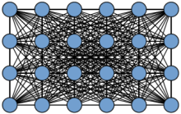
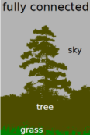
Overview
input
output
Euclidean
embedding
dense CRF +
Inference
t`
t
t
t
image
scribbles
dissimilarity
embedded pixels
[KK11]

Slide 23
Overview
t
input
output
Euclidean
embedding
dense CRF +
Inference
t`
t
t
t
image
scribbles
dissimilarity
embedded pixels
[KK11]

Slide 24
Provide dissimilarity measure between pixels
t
input
output
Euclidean
embedding
dense CRF +
Inference
t`
t
t
t
image
scribbles
dissimilarity
D( , )
pixels
embedded pixels
[KK11]

Slide 25
Overview
t
t
input
output
Euclidean
embedding
dense CRF +
Inference
t`
t
t
t
image
scribbles
dissimilarity
embedded pixels
[KK11]

Slide 26
Approximately-Euclidean pixel embedding
pixel p_{i}
pixel p_{j}
dissimilarity matrix

Slide 27
Approximately-Euclidean pixel embedding
pixel p_{i}
q_{i}
pixel p_{j}
embedding
dissimilarity matrix
q_{j}

Slide 28
Approximately-Euclidean pixel embedding
pixel p_{i}
q_{i}
pixel p_{j}
embedding
For each p_{i} find q_{i} so that
t
q_{i} - q_{j} ₂
D( , )
q_{j}
≈
holds for all pixels p_{i}

Slide 29
Landmark multidimensional scaling (LMDS) [dST02]
distance matrix might be huge
10¹² elements for 1 MPix image
stochastic sampling approach
Nystrom approximation
Complexity
time: O(N(c+p²) + c³)
space: O(Nc)

Slide 30
Landmark multidimensional scaling (LMDS) [dST02]
distance matrix might be huge
10¹² elements for 1 MPix image
stochastic sampling approach
Nystrom approximation
Complexity
time: O(N(c+p²) + c³)
space: O(Nc)
N: # pixels
c: # stochastic samples
p: dimensionality of embedding

Slide 31
Overview
t
t
input
output
Euclidean
embedding
dense CRF +
Inference
t`
t
t
t
image
scribbles
dissimilarity
embedded pixels
[KK11]

Slide 32
Overview
t
input
output
Euclidean
embedding
dense CRF +
Inference
t`
t
t
t
image
scribbles
dissimilarity
embedded pixels
[KK11]

Slide 33
Thank you

Slide 34
You can’t be serious! What about results?
Importance of embedding
Role of fully-connected CRF (FC-CRF)
Validation
Comparison with related work
Examples

Slide 35
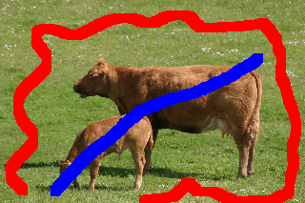
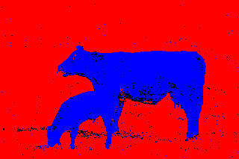
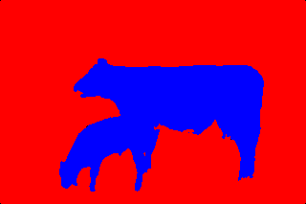
Embedding allows use of arbitrary dissimilarities
Input
Euclidean distance in RGB [KK11]
Chi-squared distance
on local histograms + FC-CCRF

Slide 36
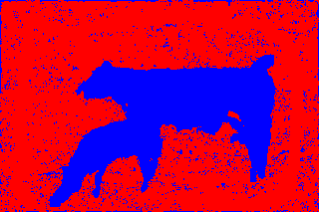
Embedding alone is not sufficiently accurate
Input
Euclidean distance in RGB [KK11]
t
Chi-squared distance (local histograms)
+ nearest neighbour labeling
Chi-squared distance
on local histograms + FC-CCRF

Slide 37
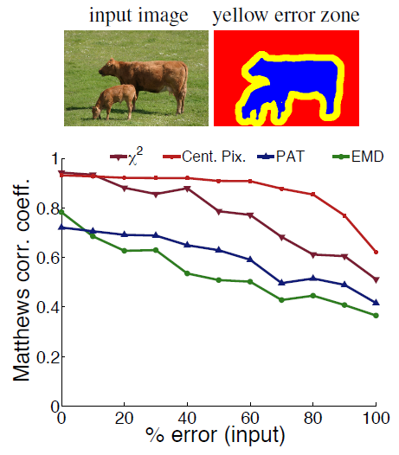
Validation: Accurate output for high input errors
Precise output
Precise input

Slide 38
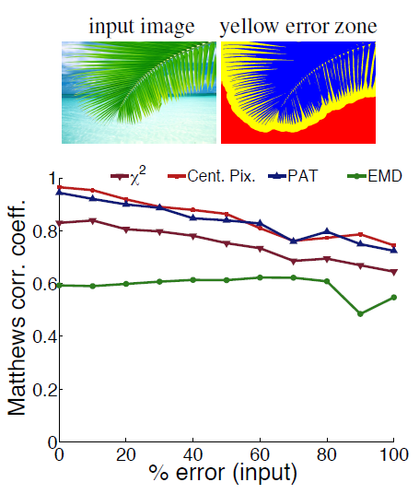
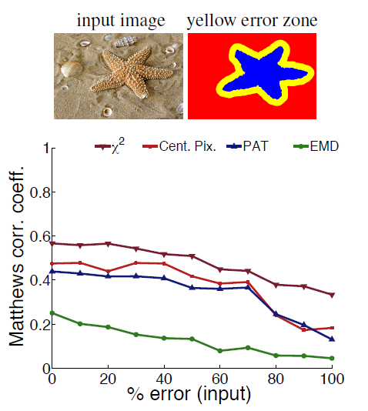
Color dominant vs texture dominant selection
Color dominant
Texture dominant

Slide 39
Qualitative comparison
[FFL10]
[CLT12]
[LJH10]
Ours

Slide 40
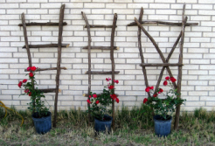
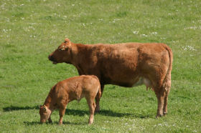
Quantitative comparison
Ours

Slide 41
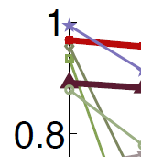
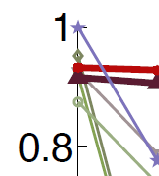
Quantitative comparison
Ours

Slide 42
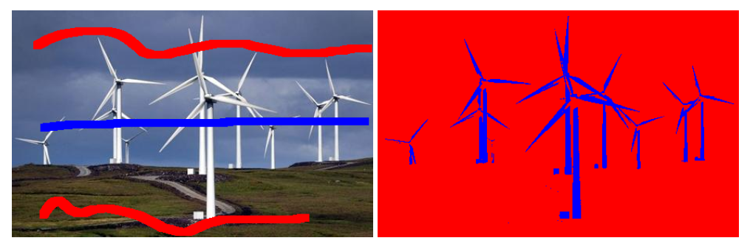
Summary
Our selection is robust
relies on relative indication of foreground and background

Slide 43
Conclusion
Most selection algorithms require precise input
ours is relatively robust
Genaralising dissimilarities is powerful
in context of pairwise potentials for FC-CRF
Two distance metrics stood out
RGB distance (colour dominant images)
Chi-squared distance on local histograms (texture dominant images)

Slide 44
Thank you

Slide 45
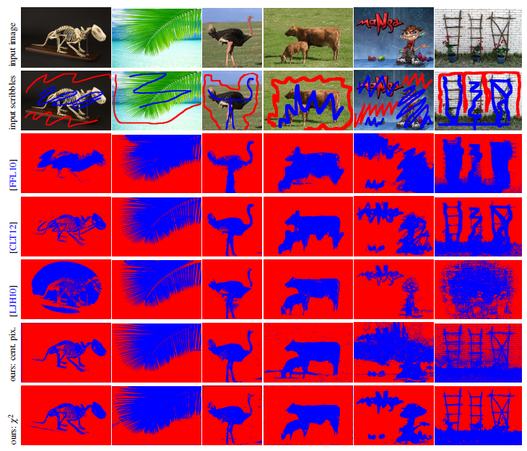
[FFL10]
[CLT12]
[LJH10]
Ours

Slide 46
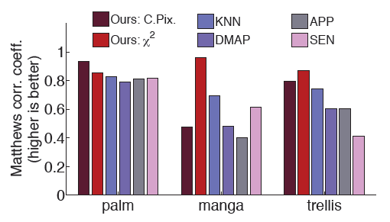
And with human scribbles

