Slide 1
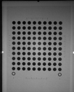
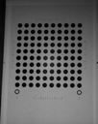
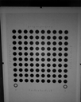
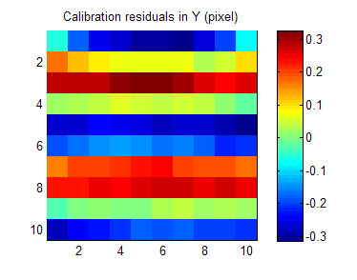
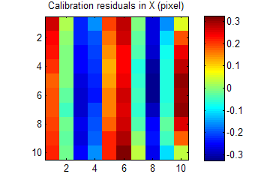
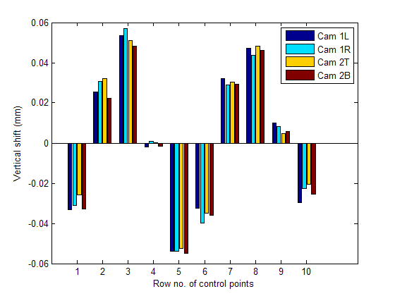
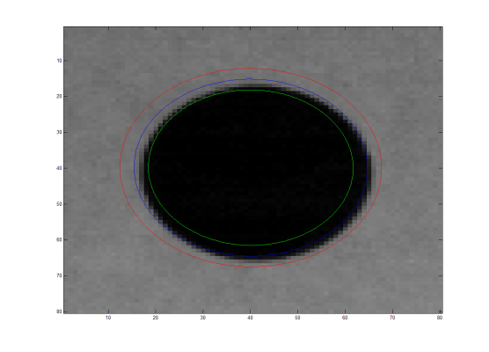
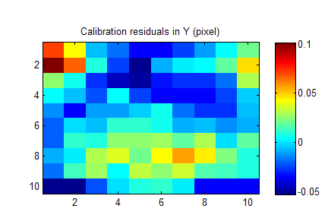
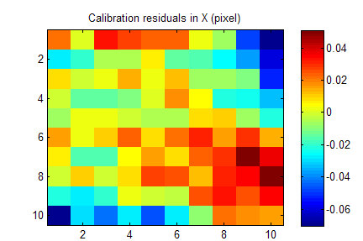
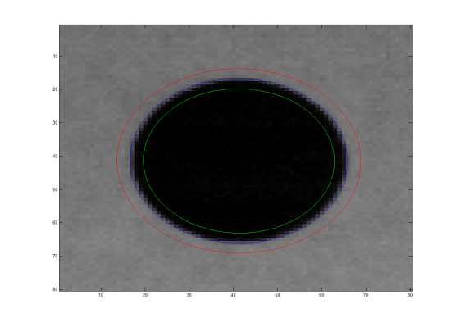
Accurate Feature Extraction and Control Point Correction for Camera Calibration with a Mono-Plane Target
Y. Xiao, R.B. Fisher, University of Edinburgh
Two problems in calibration :
Accurate extraction of feature points
Accurate estimate of 3D calibration points
Our algorithms improve both!
Control point correction:
Laser printing is NOT 100% accurate;
Printing errors produce systematic bias in calibration
Quite often ignored in vision community
Blob Detection
Raw Calibration
Ellipse Parameter Optimization
Ellipse Parameter Estimate
Multi-view of a calibration chart
Results
Synthetic data
method | MP[7] | MCP[4] | MOID
x-mean error (pixels) | 0.0156 | 0.0137 | 0.0117
y-mean error (pixels) | 0.0150 | 0.0134 | 0.0121
Real data: evaluation with 3 stereo vision systems
MOID: Maximize Outside-Inside Difference
 |  | System 1 | System 2 | System 3
Reprojection error (pixels) | MOID | 0.1094 | 0.0993 | 0.1755
 | BCoM | 0.1083 | 0.1160 | 0.1810
 | GCoM | 0.2632 | 0.1569 | 0.1951
Rectification error (pixels) | MOID | 0.0843 | 0.0600 | 0.2494
 | BCoM | 0.1023 | 0.0813 | 0.2859
 | GCoM | 0.1778 | 0.0754 | 0.2612

