Slide 1
5 July 2011
Search is not only about the Web
An Overview on Printed Documents Search and Patent Search
Walid Magdy
Centre for Next Generation Localisation
School of Computing
Dublin City University
Notes:
1

Slide 2
This Talk
Is not an introduction to Information Retrieval (IR)
Does not require experience in IR
Is not highly technical
Is not about my PhD work only
Gives overview on some IR tasks I worked on

Slide 3
Outline
Information Retrieval
Printed Documents Search
  OCR text Search
  OCRless Search
Patent Search

Slide 4
Information Retrieval
Introduction
Information Retrieval (IR) = Search
Role: retrieve answer to user’s information need
Objective: find relevant content at top ranks (usually)
The definition of relevant differs across users/tasks
Various search tasks (Web search is the most common)
Examples:
  Web search: webpages, images, news, ….
  Library search: digital books, scientific papers, ….
  Social search: friends, posts, tweets, ….
  Speech search, printed documents search, patent search
  ……………..

Slide 5
Outline
Information Retrieval
Printed Documents Search
  OCR text Search
  OCRless Search
Patent Search

Slide 6
Printed Document Search
Printed Document Search
Many books are only available in printed form
Massive efforts is moving toward digitization
Digitization is for: Availability & Information Retrieval
OCR is the main enabling technology
OCR systems is far from perfect, especially for languages of complex orthography (e.g. Arabic: WER=40%)
There is need to create high quality retrieval systems to enable reaching information in these books

Slide 7
OCR-based IR
Printed Document Search

Slide 8
Approaches
Printed Document Search
Search OCR text
  OCR error correction
  Query garbling
  Multi-OCR text fusion
Search images of text (OCRless)

Slide 9
OCR Error Correction using Error Model
OCR Search
Error Reduction: 60 to 70% (1:1 vs. m:n character alignment)
Significant improvement for retrieval effectiveness
Indistinguishable results from when searching clean text
OCR text
Corrected text
Generate Candidates
Best Fitting Word Selection
Character Error Model
Language Model
Select part and correct
Manually corrected version
Use for search
Train Error Model

Slide 10
Query Garbling using Error Model
OCR Search
Significant improvement for retrieval effectiveness
Still worse than when searching clean text
Query
Generate possible errors
Query, Ouery, Qucry, ….
Character Error Model
Use for search

Slide 11
OCR Error Correction using Edit Distance
OCR Search
Error Reduction: 56% (vs. 70% when using error model)
Significant improvement for retrieval effectiveness
Indistinguishable results from when searching clean text
OCR text
Corrected text
Generate Candidates
Best Fitting Word Selection
Edit Distance
Language Model
Dictionary
Use for search

Slide 12
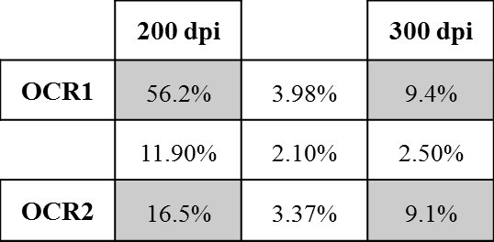
Multi-OCR Text Fusion
OCR Search
WER_{fused} << min{WER_{OCR}}
Fusion of OCR documents using the same OCR system but at different scan resolutions reduces the WER
Significant improvement in retrieval results
OCR text 1
Fused text
Word Alignment
Best Fitting Word Selection
OCR text 2
Language Model
Use for search

Slide 13
OCR Search
OCR Search
Recognition errors in OCR text degrades retrieval
Different methods of text processing can overcome the negative effect of retrieval and improves search
Some training and resources are needed which can be manual correction, trained language model, or both
Research Outcomes
  Publications (ACM TOIS, Springer IR, EMNLP, SPIRE, …)
  MSc degree

Slide 14
Searching Printed Document without OCR
OCRless Search
Text Domain
Image Domain
Query
Query
Query
Information
Information
Information
Draw
OCR
X Domain
Irt0rniatiom
Information
Query
Effectiveness & Efficiency

Slide 15
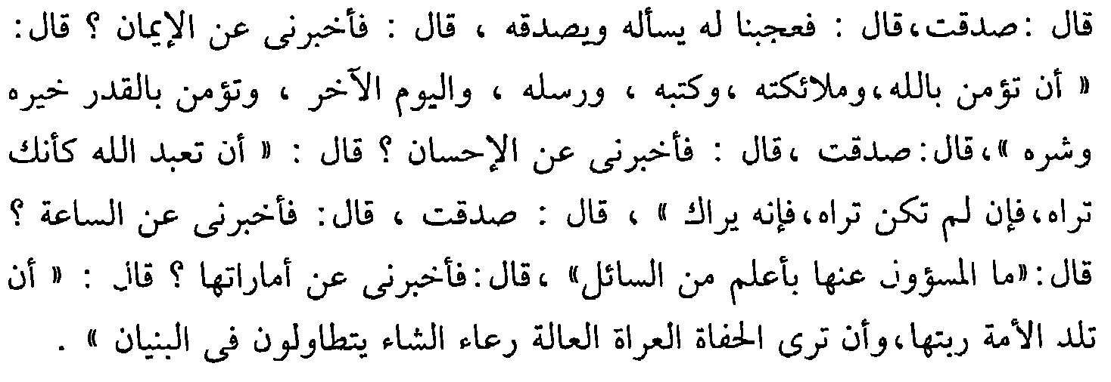





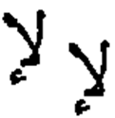


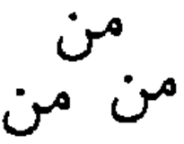
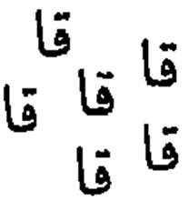
Scenario (Index Phase)
OCRless Search
Segment to elements
Clustering
Cluster ID
126
61
Cluster
213 31 89 32 2 213 31 3341 1190 23 802 …
Create IDs document
42
Indexing
831
Index of IDs
301

Slide 16

Scenario (Query Phase)
OCRless Search
الإيمان
Draw query
Replace with candidate IDs and formulate query
List of ranked documents
syn(1284, 21, 673, 1208)
syn(430, 4, 6412, 3094)
syn(231, 9011, 32, 721)
syn(40, 110, 2213, 2214)
Search Index of IDs

Slide 17

Architecture
OCRless Search
Segment to elements
Cluster elements
Index Phase
Index
of IDs
Index
Order IDs
Replace element image with ID
Clusters of elements
Text Query
Draw Query
Match elements to clusters
List of Candidate IDs for each element with scoring
Query Phase
Ranked
Results
Search
Formulate Query

Slide 18


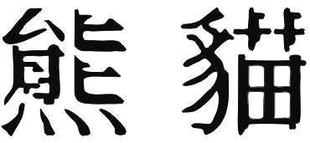
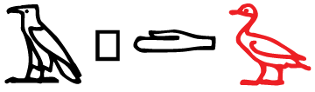
OCRless
OCRless
Effective and fast
Robust to OCR errors
No training resources required
Language independent
Research Outcomes
  Patent (filed by Microsoft in 2008)
  Publication (SPIRE)
  TechFest Demo
  The same engine for searching printed documents in:
  Arabic, English, Chinese, Hebrew, and Hieroglyphic
English

Slide 19
Outline
Information Retrieval
Printed Documents Search
  OCR text Search
  OCRless Search
Patent Search

Slide 20

Patent Search
Patent Search
Given a patent application, check if the invention described is novel
Search
Query
Results list
A System and Method for …
………………………………………………………………………………………………………………………………..
Patent Collection
Patent application
Several languages
Many results to check

Slide 21
Properties
Patent Search
Task: Find related patents to an invention (check novelty)
Nature: Recall-oriented search task
Objective: Find all possible relevant documents
Search time: takes much longer
Users: Patent examiners (experts in field of search)
Involves cross-language search
Huge effort & amount of money for search
IR evaluation campaigns: NTCIR, CLEF, TREC

Slide 22
State-of-the-art
Patent Search
Patent application → Query (80% of research)
  Which fields in patents to be considered in query formulation
  Query terms weighting
  Keywords extraction
Cross-language patent search (10%)
  Translation dictionaries
  Mixed language index
Retrieval models, query expansion, image search.. (10%)
Avg. achieved MAP ~ 0.1
Contribution: Evaluation and Cross-language search

Slide 23
Evaluation
Patent Search Evaluation
Recall is the objective
Precision is also important
Huge # documents checked (100-600 documents)
Evaluation: average precision (AP)!!
  Focuses on finding relevant documents early in ranked list
  Has weak reflection of recall

Slide 24

Example
Patent Search Evaluation
For a topic with 4 relevant docs and 1st 100 docs to be examined:
System1: relevant ranks = {1}
System2: relevant ranks = {50, 51, 53, 54}
System3: relevant ranks = {1, 2, 3, 4}
AP_{system1} = 0.25
AP_{system2} = 0.0481
AP_{system3} = 1
R_{system1} = 0.25
R_{system2} = 1
R_{system3} = 1
We need a metric that reflects recall and ranking quality in one measure

Slide 25
Patent Retrieval Evaluation Score
Patent Search Evaluation
n: number of relevant docs
r_{i}: the rank at which the i^{th} relevant document is retrieved
N_{max}: max number of checked docs

Slide 26
PRES
Patent Search Evaluation
Gives higher score for systems achieving higher recall and better average relative ranking
Dependent on user’s potential/effort (N_{max})
Very robust with incomplete relevance judgements.
Used in the CLEF-IP evaluation task.
Research Outcomes
  Publications (SIGIR, CLEF)
  License agreement for CLEF-IP organisers to use PRES
  Currently the standard metric for evaluating patent search

Slide 27
Cross-Language Patent Search
Cross-Language Patent Search
Patent queries are very long
Dictionary-based translation quality < MT
MT takes significant time
Domain specific data required
Limited resources for many language pairs
Problems: time and resources

Slide 28
Idea
Cross-Language Patent Search
Manual translation:
MT output:
MT evaluation: MT sucks
IR evaluation: MT rocks ☺
Questions:
  Can we create an MT4IR system?
  What benefits can be achieved?
It is a great idea to apply stemming in information retrieval
great idea apply stem information retriev
i
he are an great ideas to applied stem by information retrieving
great idea appli stem information retriev

Slide 29
Current Approach vs New Approach
Cross-Language Patent Search
Query
(lang x)
Translate
MT Model
(lang x→y)
Query
(lang y)
lang x,
Process
Train MT
Query (lang y, no stop words, and stemmed)
Index
(lang y)
Search
Parallel Corpus
Results
(lang y)

Slide 30
Experimentation
Cross-Language Patent Search
English patent collection
French patent topics
8M parallel sentences from patent domain
Test new approach (processed MT) vs ordinary approach (ordinary MT)
Multiple training sets: 8M, 800k, 80k, 8k, and 2k
Test retrieval effectiveness and processing time
Baselines:
  Google translate: 0.413 PRES
  MaTrEx (8M training set): 0.413 PRES, tr_{time} = 31mins/topic

Slide 31
Results (retrieval effectiveness)
Cross-Language Patent Search

Slide 32
Results (OOV)
Cross-Language Patent Search
E.g. play, plays, played, playing

Slide 33
Results (translation time)
Cross-Language Patent Search
20 times faster
9 times faster
5 times faster

Slide 34
MT4IR
Cross-Language Patent Search
Much² faster than ordinary MT
Similar retrieval results
Better with limited MT training resources
Research Outcomes
  Publications (ECIR, SIGIR)
  Patent (filed by DCU in 2011)

Slide 35
Conclusion
Conclusion
Search is not only about the web
Many search tasks have different natures and challenges
Sometimes solution for a problem in one task can be useful to improve performance for another one
Thinking of problems differently usually leads to novel and effective results
It does not have to be complicated to be a good idea

Slide 36
Thank you

